Slide 1
CS 589 Fall 2020
Text Mining and Information Retrieval
Instructor: Susan Liu
TA: Huihui Liu
Stevens Institute of Technology

Slide 2
Welcome to CS589
Instructor: Susan (Xueqing) Liu
Email: xliu127@stevens.edu
Office hour (935 8556 9660): Tuesday 9:00-11:00
TA:
Huihui Liu hliu79@stevens.edu
Office hour: Friday 2:00-4:00
Notes:
we use Google playstore data as the data source, so we collect these data, we clean it, we split the sentence, and we build a filtering algorithm to select the high quality sentence

Slide 3
Who am I?
Assistant professor
PhD@UIUC 2019
My research:
Helping users (especially software developers) to more quickly search for information
my research
software engineering, security
ML
Text mining/IR
Notes:
we use Google playstore data as the data source, so we collect these data, we clean it, we split the sentence, and we build a filtering algorithm to select the high quality sentence

Slide 4
What is CS589 about?
Text Mining
The study of extracting high quality information from raw texts
Information retrieval
The study of retrieving relevant information/resources/knowledge to an information need
Notes:
creates the building block of more advanced techniques

Slide 5
Information Retrieval Techniques
“Because the systems that are accessible today are so easy to use, it is tempting to think the technology behind them is similarly straightforward to build. This review has shown that the route to creating successful IR systems required much innovation and thought over a long period of time. “
— The history of Information Retrieval Research, Mark Sanderson and Bruce Croft
Notes:
creates the building block of more advanced techniques

Slide 6
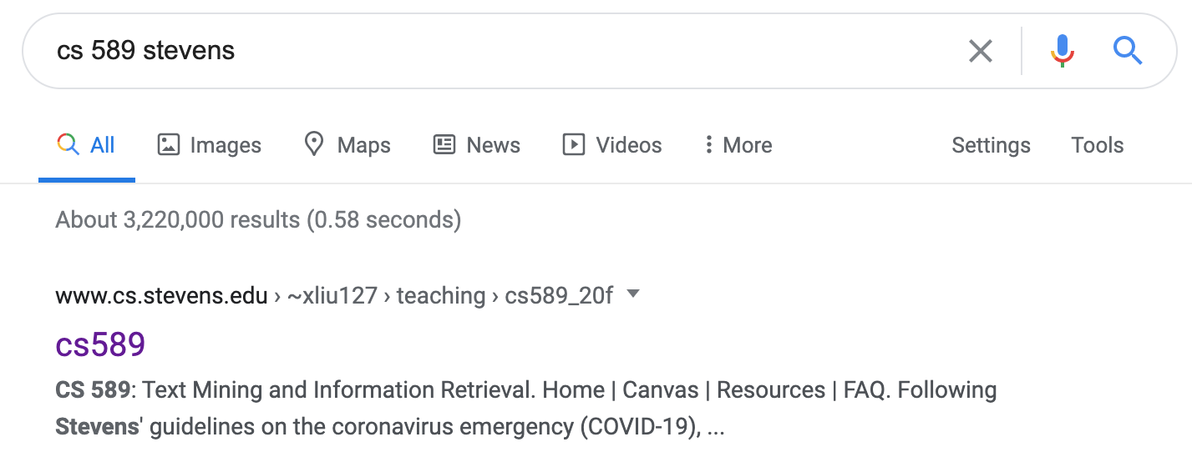
Information Retrieval Techniques
How does Google know cs 589 refers to a course?
How does Google know stevens = SIT?
How does Google return results so quickly?
Notes:
creates the building block of more advanced techniques

Slide 7
Information Retrieval Techniques
Getting enough coverage of users’ information need
Query understanding, personalization, results diversification, result page optimization, etc.
Making sure the results are returned to users fast
Notes:
creates the building block of more advanced techniques

Slide 8
A Brief History of IR
1958
Cranfield evaluation methodology; word-based indexing
300 BC
1960s
building IR systems on computers; relevance feedback
Callimachus: the first library catalog
1970s
TF-IDF; probability ranking principle
1980s
TREC; learning to rank; latent semantic indexing
1950s
1990 - now
web search; supporting natural language queries;
Punch cards, searching at 600 cards/min
Notes:
creates the building block of more advanced techniques

Slide 9

Information need
information need
“An individual or group's desire to locate and obtain information to satisfy a need”, e.g., question answering, program repair, route planning
query
A (short) natural language representation of users’ information need
Notes:
creates the building block of more advanced techniques

Slide 10
The Boolean retrieval system
Notes:
creates the building block of more advanced techniques

Slide 11
The Boolean retrieval system
Notes:
creates the building block of more advanced techniques

Slide 12
The Boolean retrieval system
e.g., SELECT * FROM table_computer WHERE price < $500 AND brand = “Dell”
Primary commercial retrieval system for 3 decades
Many systems today still use the boolean retrieval system, i.e., faceted search
Library catalog, eCommerce search, etc.
Advantage: Returns exactly what you want
Disadvantage:
can only specify queries based on the pre-defined categories
two few / two many queries
Notes:
creates the building block of more advanced techniques

Slide 13
The Boolean retrieval system
The user may specify a condition that does not exist
Notes:
creates the building block of more advanced techniques

Slide 14
The Cranfield experiment (1958)
Imagine you need to help users search for literatures in a digital library, how would you design such a system?
computer science
query = “subject = AI & subject = bioinformatics”
artificial intelligence
bioinformatics
system 1: the Boolean retrieval system
Notes:
creates the building block of more advanced techniques

Slide 15
The Cranfield experiment (1958)
Imagine you need to help users search for literatures in a digital library, how would you design such a system?
Document-term matrix
 | intelligence | book | the | cat | artificial | dog | business
Doc1 | 0 | 1 | 3 | 1 | 0 | 1 | 0
Doc2 | 1 | 0 | 0 | 0 | 0 | 0 | 1
query | 1 | 0 | 1 | 0 | 1 | 0 | 0
artificial
query = “ the artificial intelligence”
bags of words representation
system 2: indexing documents by lists of words
Notes:
creates the building block of more advanced techniques

Slide 16
The Cranfield experiment (1958)
system 1
compare
system 2
Boolean retrieval system < word indexing system
Notes:
creates the building block of more advanced techniques

Slide 17
Word indexing: vector-space model
Represent each document/query as a vector
The similarity = cosine score between the vectors
Notes:
creates the building block of more advanced techniques

Slide 18
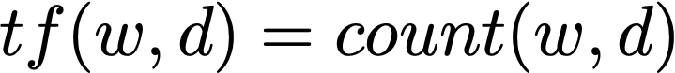
Term frequency
Document-term matrix
 | intelligence | book | the | cat | artificial | dog | business
Doc1 | 0 | 1 | 3 | 1 | 0 | 1 | 0
Doc2 | 1 | 0 | 0 | 0 | 0 | 0 | 1
query | 1 | 0 | 1 | 0 | 1 | 0 | 0
artificial
d1 = [0, 1, 3, 1, 0, 1, 0]
d2 = [1, 0, 0, 0, 0, 0, 1]
query = “the business intelligence”
q = [1, 0, 1, 0, 1, 0, 0]
Notes:
creates the building block of more advanced techniques

Slide 19
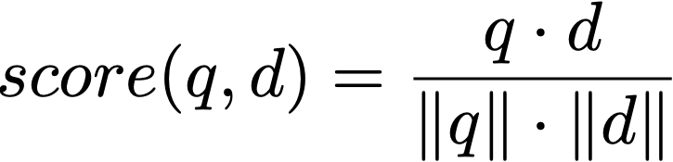
Vector space model
Document-term matrix
 | intelligence | book | the | cat | artificial | dog | business
Doc1 | 0 | 1 | 3 | 1 | 0 | 1 | 0
Doc2 | 1 | 0 | 0 | 0 | 0 | 0 | 1
query | 1 | 1 | 1 | 0 | 1 | 0 | 0
To answer the query:
“the artificial intelligence book”
q = [1, 1, 1, 0, 1, 0, 0]
d1 = [0, 1, 3, 1, 0, 1, 0]
d2 = [1, 0, 0, 0, 0, 0, 1]
Notes:
creates the building block of more advanced techniques

Slide 20
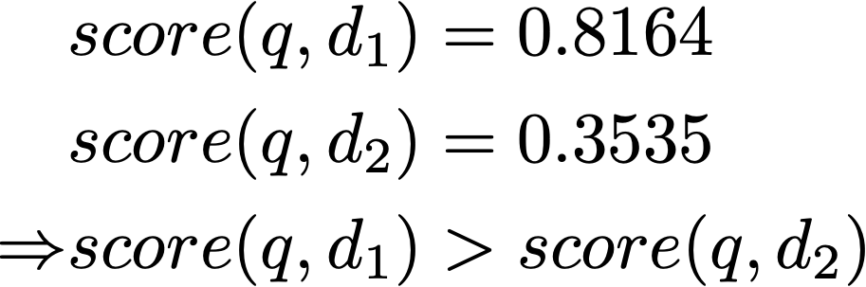
TF-only representations is inaccurate
Documents are dominated by words such as “the” “a”
These words do not carry any meanings, nor do they discriminate between documents
q = “the artificial intelligence book”
d1 = “the cat, the dog, and the book”
d2 = “business intelligence”
Notes:
creates the building block of more advanced techniques

Slide 21
Zipf’s law distribution of words
Notes:
creates the building block of more advanced techniques

Slide 22
Stop words
Documents are dominated by words such as “the” “a”
These words do not discriminate between documents
Notes:
creates the building block of more advanced techniques

Slide 23
Desiderata for a good ranking function
If a word appears everywhere, it should be penalized
If a word appears in the same document multiple times, it’s importance should not grow linearly
q = “artificial intelligence”
d1 = ““Artificial intelligence was founded as an academic discipline in 1955, and in the years since has experienced several waves of optimism”
d2 = ““Artificial intelligence was founded as an academic discipline in 1955, artificial intelligence”
d2 is not twice more relevant than d1
Notes:
creates the building block of more advanced techniques

Slide 24
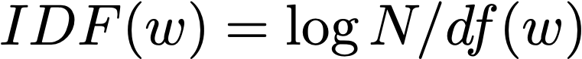
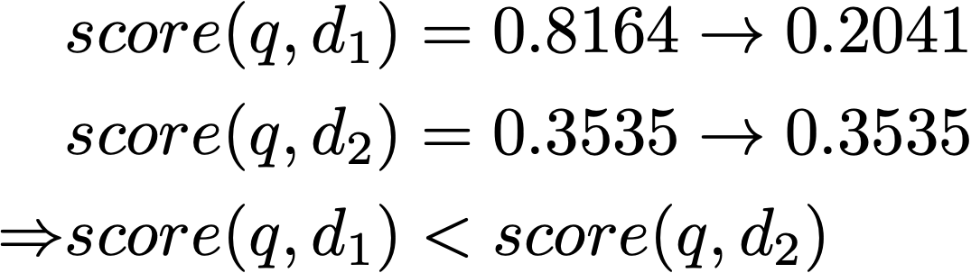
Inverse-document frequency
Inverse-document frequency: penalizing a word’s TF based on its document frequency
q = “the artificial intelligence book”
d1 = “the cat, the doc, and the book”
d2 = “business intelligence”
TF-IDF weighting
Notes:
creates the building block of more advanced techniques

Slide 25
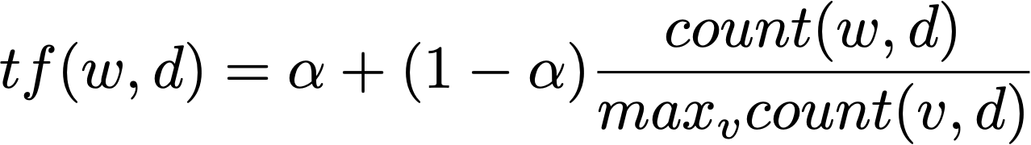
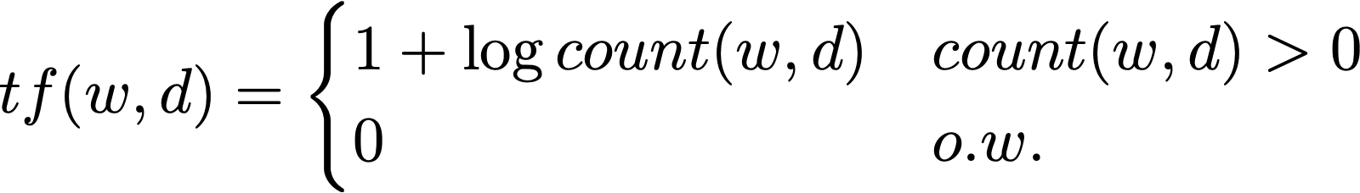
Term frequency reweighing
Term frequency reweighing: penalizing a word’s TF based on the TF itself
If a word appears in the same document multiple times, it’s importance should not grow linearly
Max TF normalization
Log scale normalization
Notes:
creates the building block of more advanced techniques

Slide 26
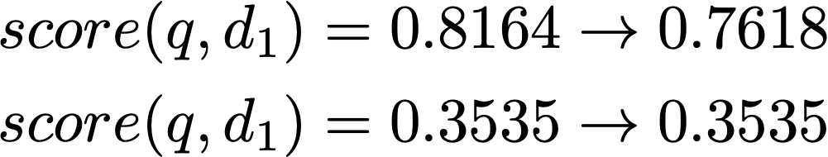
Term-frequency reweighing
Logarithmic normalization
Log scale normalization
q = “the artificial intelligence book”
d1 = “the cat, the doc, and the book”
d2 = “business intelligence”
Notes:
creates the building block of more advanced techniques

Slide 27
Retrieving short documents vs. retrieving long documents
The difference between retrieving short documents and long documents
Longer documents cover more topics, so the query may match a small subset of the vocabulary
Longer documents need to be considered differently
q = “artificial intelligence”
d1 = “artificial intelligence book”
d2 = “Artificial intelligence was founded as an academic discipline in 1955, and in the years since has experienced several waves of optimism “
Notes:
creates the building block of more advanced techniques

Slide 28
Retrieving short documents vs. retrieving long documents
The difference between retrieving short documents and long documents
Longer documents cover more topics, so the query may match a small subset of the vocabulary
Longer documents need to be considered differently
Short document
the
a
business
intelligence
Long document
ML
the
a
learn
NLP
business
bot
AI
Notes:
creates the building block of more advanced techniques

Slide 29
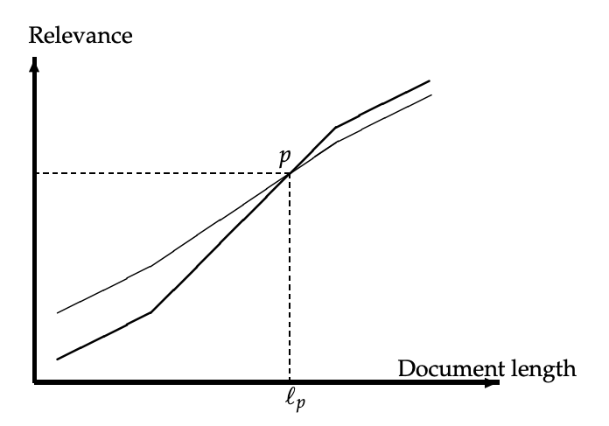
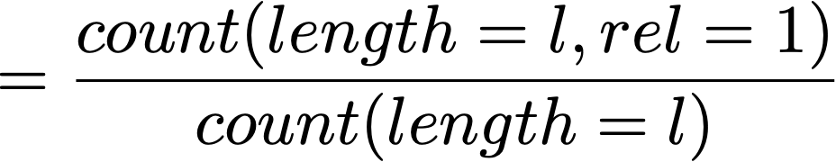
Document length pivoting
For each query q and each document d, compute their relevance score score(q, d)
Manually evaluate the relevance between q and d
relevance judg@l
relevance score
Notes:
creates the building block of more advanced techniques

Slide 30
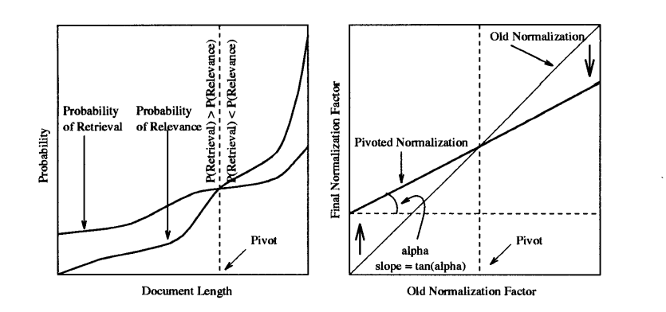

Document length pivoting
Rotate the relevance score curve, such that it most closely align with the relevance judgement curve
Notes:
creates the building block of more advanced techniques

Slide 31
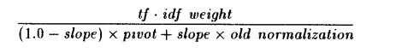
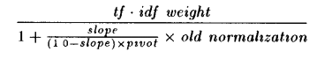
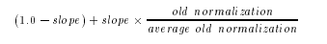
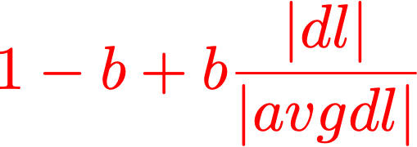
Document length pivoting
Rotate the relevance score curve, such that it most closely align with the relevance judgement curve
fixing pivot to avgdl
standard formulation for doc length normalization
Notes:
creates the building block of more advanced techniques

Slide 32
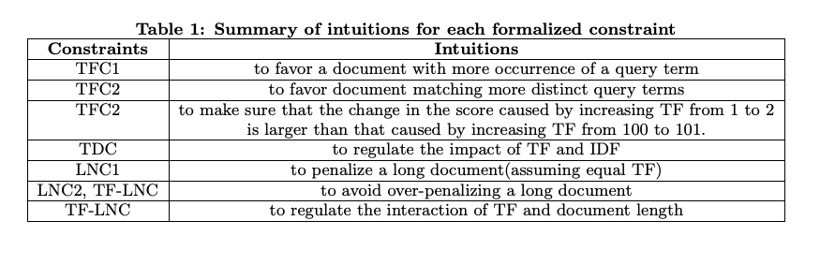
More on retrieval model design heuristics
Axiomatic thinking in information retrieval [Fang et al., SIGIR 2004]
Notes:
creates the building block of more advanced techniques

Slide 33
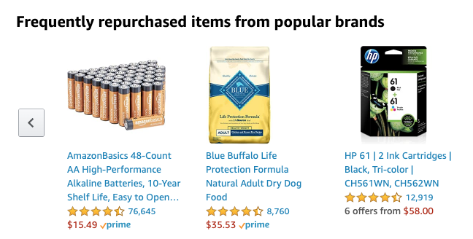
IR != web search
The other side of information retrieval techniques
Recommender systems (users who bought this also bought…)
Online advertising
Notes:
creates the building block of more advanced techniques

Slide 34
IR != web search
Factoid question answering systems
Notes:
creates the building block of more advanced techniques

Slide 35
What about text mining?
AI/ML
Data mining
document classification
document clustering
information extraction
Text Mining
NLP
Database
text summarization
sentiment analysis
IR
web search & mining
Notes:
creates the building block of more advanced techniques

Slide 36
Syllabus
Vector space model, TF-IDF
EM algorithm
RNN/LSTM
Probability ranking principle, BM25
Transformer/Bert
IR evaluation, query completion
Inverted index, ES, PageRank, HITS
Relevance feedback, PRF
Frontier topic: recommender system
Neural IR
Frontier topic: opinion analysis/mining
Frontier topic: NMT, program synthesis
Notes:
creates the building block of more advanced techniques

Slide 37
Assignment goals
Upon successful completion of this course, students should be able to:
Evaluate ranking algorithms by using information retrieval evaluation techniques, and implement text retrieval models such as TF-IDF and BM25;
Use Elastic search to implement a prototypical search engine on Twitter data;
Derive inference algorithms for the maximum likelihood estimation (MLE), implement the expectation maximization (EM) algorithm;
Use state-of-the-art tools such as LSTM/Bert for text classification tasks
Notes:
creates the building block of more advanced techniques

Slide 38
Prerequisite
CS115 is required for undergrad, CS284 is recommended (data structure in Java)
Fluency in Python is required
A good knowledge on statistics and probability
Knowledge of one or more of the following areas is a plus, but not required: Information Retrieval, Machine Learning, Data Mining, Natural Language Processing
Contact the instructor if you aren’t sure
Notes:
creates the building block of more advanced techniques

Slide 39
Format
Meeting (946 9169 6894): every Monday 6:15-8:45
4 programming assignments
Submit code + report (written in PDF)
1 midterm
in class
Final project
Notes:
creates the building block of more advanced techniques

Slide 40
Final Project
Oct 19
- Oct 26
Students choose a topic; for each topic, they pick 2-3 coherent papers, and write a summary for the paper
Oct 26 - Nov 16
Students who share the same interest are categorized into groups; each group propose a novel research topic motivated by their survey
Dec 14
Deliver a presentation in Week 14
Dec 20
Submit their implementation (code in Python) as well as an 8-page academic paper as their final project.
Notes:
creates the building block of more advanced techniques

Slide 41
Grading
Homework - 40%, Midterm - 30%, Project - 30%
Late policy
Submit within 24 hours of deadline - 90%, within 48 hours - 70%, 0 if code not compile
Late by over 48 hours are generally not permitted
Medical conditions
A sudden increase in family duty
Too much workload from other courses
The assignment is too difficult
Notes:
creates the building block of more advanced techniques

Slide 42
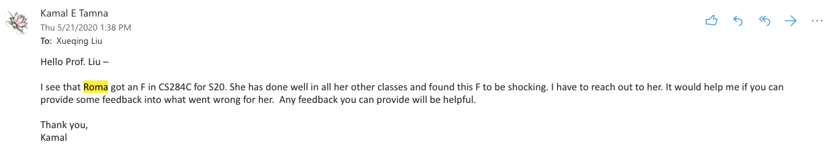
Plagiarism policy
We have a very powerful plagiarism detection pipeline, do not take the risk
Cheating case in CS284
A student put all his homework on a GitHub public repo
In the end, we found 8+ students copied his code
Notes:
creates the building block of more advanced techniques

Slide 43

Question answering
Please do not ask your questions in Canvas, most questions can be asked on Piazza, otherwise use emails
Notes:
creates the building block of more advanced techniques

Slide 44
Question asking protocol
Regrading requests: email TA, cc myself, titled [CS589 regrading]
Deadline extension requests: email myself, titled [CS589 deadline]
Dropping: email myself, titled [CS589 drop]
All technical questions: Piazza
Homework description clarification
Clarification on course materials
Having trouble with homework: join my office hour directly, no need to email me
If you have a time conflict, email me & schedule another time
Project discussion: join my office hour
Ask any common questions shared by the class on Piazza
Notes:
creates the building block of more advanced techniques

Slide 45
Your workload
Aug
Sept
Oct
Nov
Dec
First Day of
Instruction
Thanks-
giving
Last Day
of Instruction
Lectures/Readings
Programming Assignments
Midterm
Project
Notes:
creates the building block of more advanced techniques

Slide 46
Books
No text books
Recommended readings:
Zhai, C., & Massung, S. (2016). Text data management and analysis: a practical introduction to information retrieval and text mining. Association for Computing Machinery and Morgan & Claypool
Christopher D. Manning, Prabhakar Raghavan and Hinrich Schütze, Introduction to Information Retrieval, Cambridge University Press. 2008
Notes:
creates the building block of more advanced techniques

